Slide 1
Predictive Analytics & Modeling Membership, Market and Sales Analytics (MMSA)
Instrument Variables
March 2020

Slide 2
Learning objectives
Gain a fundamental understanding of omitted variable bias (i.e. misspecification)
Gain a fundamental understanding of how to use instrument variables to solve for omitted variable bias
Develop a practical understanding of how to implement instrument variables

Slide 3
OLS (regression) assumptions
Assumption 1: The regression model is linear in the coefficients and the error term
Assumption 2: Strict exogeneity. The errors in the regression should have conditional mean zero
Assumption 3: There is a random sampling of observations
Assumption 4: There is no perfect collinearity between your independent variables
Assumption 5: There is homoskedasticity and no autocorrelation
Assumption 6: Error terms should be normally distributed

Slide 4
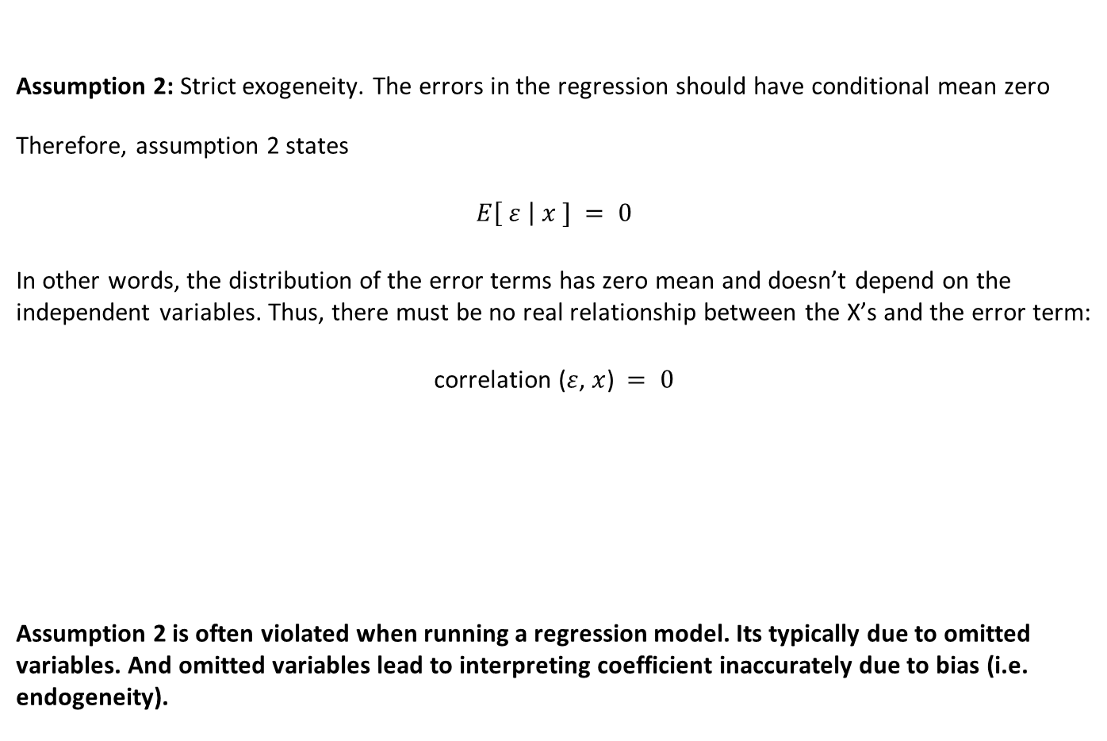
Assumption 2: strict exogeneity
Assumption 2: Strict exogeneity. The errors in the regression should have conditional mean zero
Therefore, assumption 2 states
$$E\left[ ε \right| x ] = 0$$
In other words, the distribution of the error terms has zero mean and doesn’t depend on the independent variables. Thus, there must be no real relationship between the X’s and the error term:
correlation ($ε$, $x$) $= 0$
Assumption 2 is often violated when running a regression model. Its typically due to omitted variables. And omitted variables lead to interpreting coefficient inaccurately due to bias (i.e. endogeneity).

Slide 5
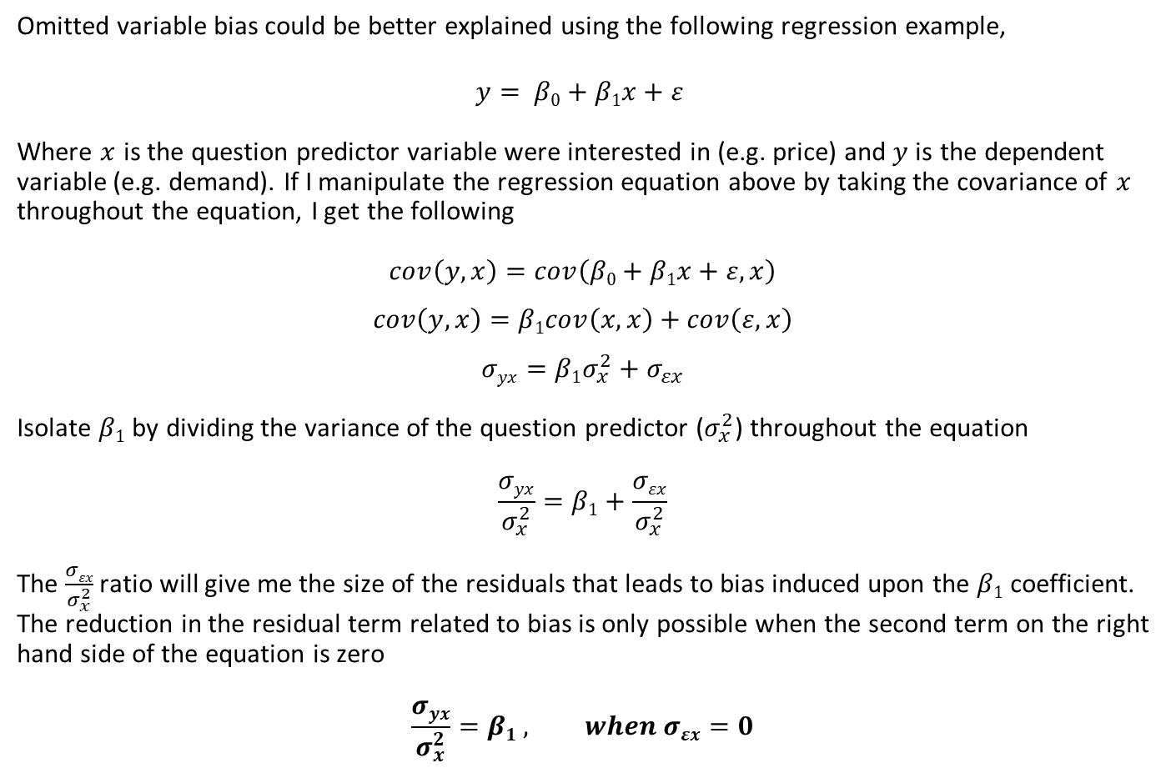
A better look at where the bias exists
Omitted variable bias could be better explained using the following regression example,
$$y= β0+β1x+ε$$
Where $x$ is the question predictor variable were interested in (e.g. price) and $y$is the dependent variable (e.g. demand). If I manipulate the regression equation above by taking the covariance of $x$ throughout the equation, I get the following
$$cov\left(y,x\right)=cov\left(β0+β1x+ε,x\right)$$
$$cov\left(y,x\right)=β1cov\left(x,x\right)+cov\left(ε,x\right)$$
$$σyx=β1σ_{x}^{2}+σ_{εx}$$
Isolate $β1$ by dividing the variance of the question predictor ($σ_{x}^{2}$) throughout the equation
$$\frac{σyx}{σ_{x}^{2}}=β1+\frac{σεx}{σ_{x}^{2}}$$
The $\frac{σεx}{σ_{x}^{2}}$ ratio will give me the size of the residuals that leads to bias induced upon the $β1$ coefficient. The reduction in the residual term related to bias is only possible when the second term on the right hand side of the equation is zero
$$\frac{σyx}{σ_{x}^{2}}=β1 , when σεx=0$$

Slide 6
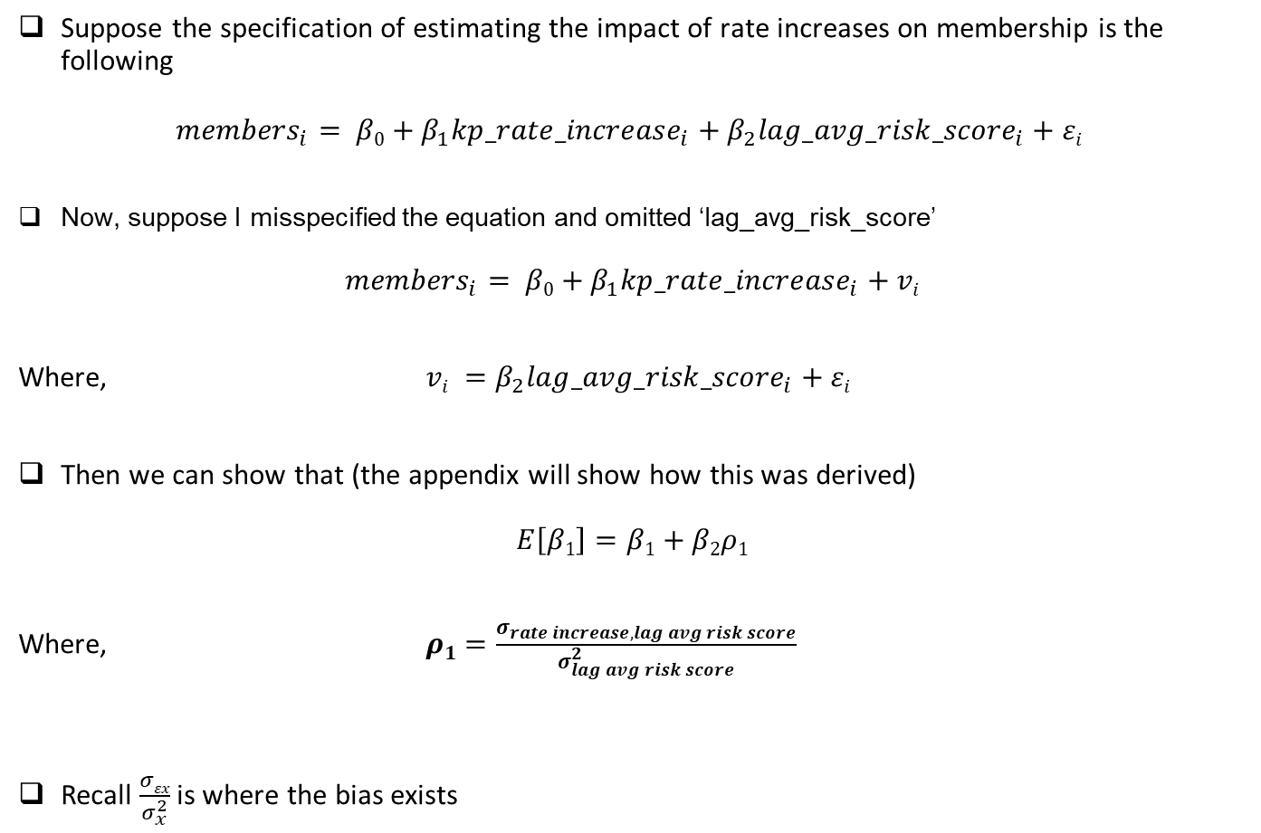
Example: omitted variable bias in action
Suppose the specification of estimating the impact of rate increases on membership is the following
$${members}_{i}= β0+β_{1}{kp_rate_increase}_{i}+β_{2}{lag_avg_risk_score}_{i}+εi$$
Now, suppose I misspecified the equation and omitted ‘lag_avg_risk_score’
$${members}_{i}= β0+β_{1}{kp_rate_increase}_{i}+vi$$
Where, $vi =β_{2}{lag_avg_risk_score}_{i}+εi$
Then we can show that (the appendix will show how this was derived)
$E\left[β1\right]=β1+β2ρ1$
Where, $ρ1=\frac{σ_{rate increase, lag avg risk score}}{σ_{lag avg risk score}^{2}}$
Recall $\frac{σεx}{σ_{x}^{2}}$ is where the bias exists

Slide 7




A visual inspection of variation and covariation
Using a Venn diagram as a visual analogy for variation and covariation between outcome and variables of interest provides a useful explanatory tool.
The ratio of the area of intersection to the total area of the upper ellipse represents the portion of the total variability in outcome Y that has been predicted by X (it is estimated by the R² statistic)
Variation in outcome Y, $σ_{y}^{2}$
Recall,
$\frac{σyx}{σ_{x}^{2}}=β1$
The covariance, $σ_{yx}$
Variation in the variable of interest X, $σ_{x}^{2}$
Notes:
If I ran a regression: y = b0 + b1x + e
The error term (or residual) would be what the complement of x (the variation of y that is not explained by x).

Slide 8
Solving the endogeneity problem by the use of instrument variables
Statistical patterns detected in observational data do not, on their own, provide evidence of causal relationships!
Most of our analysis, were not relying on investigator designed experiments to provide the required exogenous variation.
In statistics, as in life, it is usually the case that we can always do better if we have some way to incorporate additional useful information input our decision.
For instance, it might be possible to locate and carve out an exogenous part of the variability in the endogenous variable of interest and use it to estimate the impact it has on our dependent variable. This is where instrument variables (IVs) come into play.
To make IVs work, I must have data for each observation in my dataset on a special kind of background variable that is called an instrument.
By integrating this instrument in a particular way onto the analysis, I can identify exogenous variation that is present in the variable of interest, and use it to obtain an asymptotically unbiased estimate of its causal impact on the dependent variable.

Slide 9
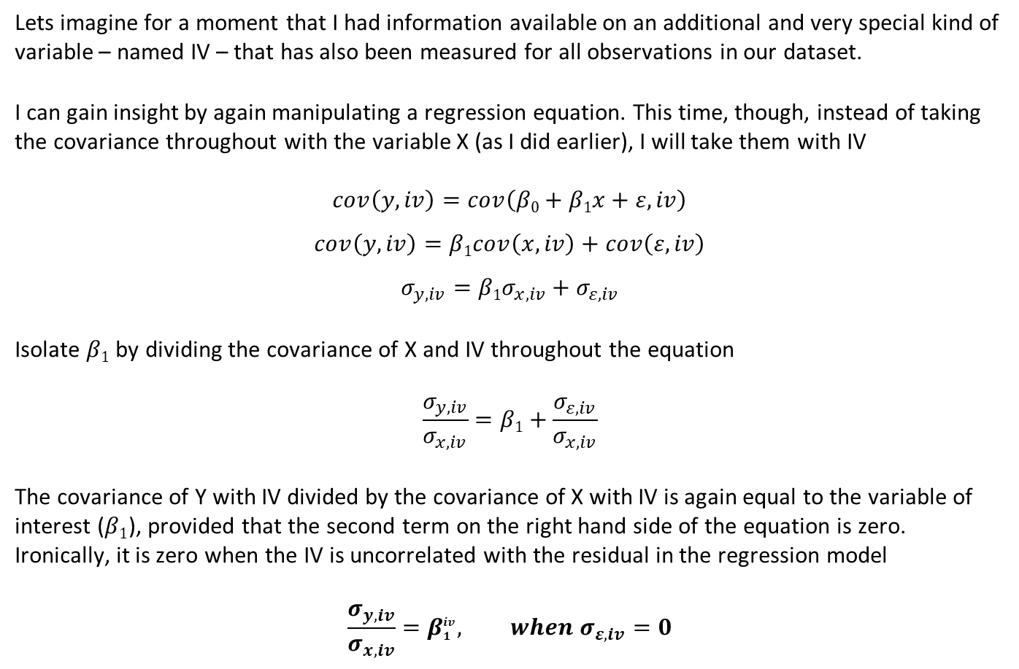
A better look at estimating $β_{1}^{iv}$
Lets imagine for a moment that I had information available on an additional and very special kind of variable – named IV – that has also been measured for all observations in our dataset.
I can gain insight by again manipulating a regression equation. This time, though, instead of taking the covariance throughout with the variable X (as I did earlier), I will take them with IV
$$cov\left(y,iv\right)=cov\left(β0+β1x+ε,iv\right)$$
$$cov\left(y,iv\right)=β1cov\left(x,iv\right)+cov\left(ε,iv\right)$$
$$σ_{y,iv}=β1σ_{x,iv}+σ_{ε,iv}$$
Isolate $β1$ by dividing the covariance of X and IV throughout the equation
$$\frac{σ_{y,iv}}{σ_{x,iv}}=β1+\frac{σ_{ε,iv}}{σ_{x,iv}}$$
The covariance of Y with IV divided by the covariance of X with IV is again equal to the variable of interest ($β1$), provided that the second term on the right hand side of the equation is zero. Ironically, it is zero when the IV is uncorrelated with the residual in the regression model
$$\frac{σ_{y,iv}}{σ_{x,iv}}=β_{1}^{iv}, when σ_{ε,iv}=0$$
Notes:
Because statisticians refer to covariance as one the second moments of a bivariate distribution, the expression on the right hand side is referred to the method of moments IV of B1

Slide 10
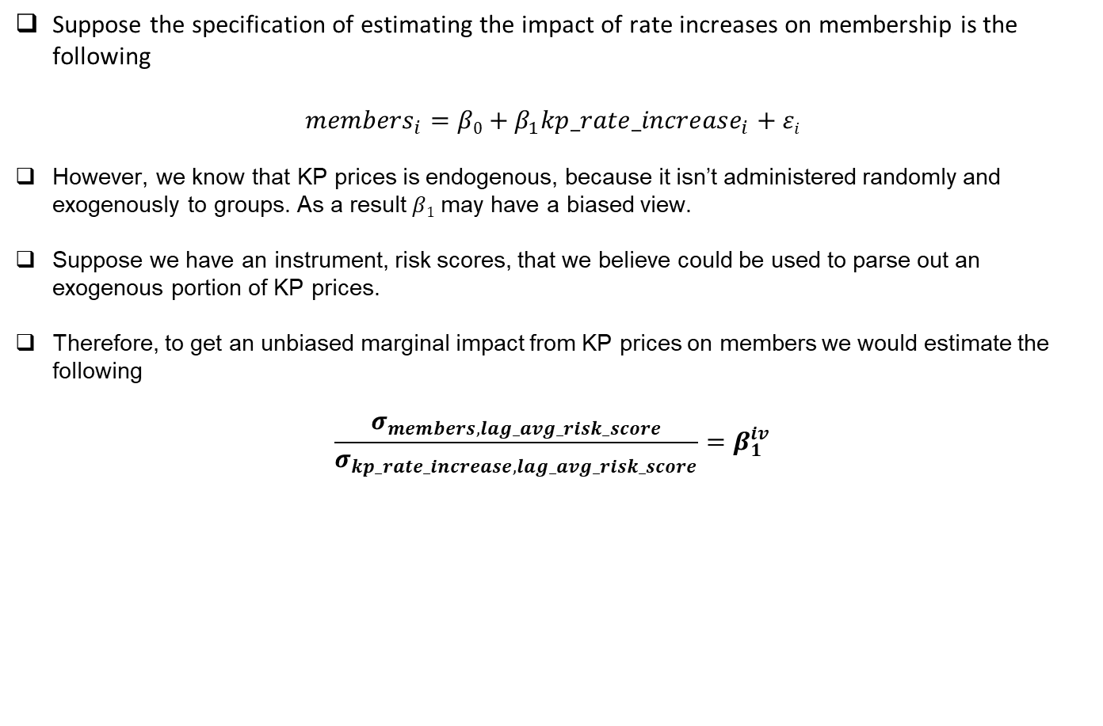
Example: instrument variable estimation (method-of-moments approach)
Suppose the specification of estimating the impact of rate increases on membership is the following
$${members}_{i}=β0+β_{1}{kp_rate_increase}_{i}+εi$$
However, we know that KP prices is endogenous, because it isn’t administered randomly and exogenously to groups. As a result $β1$ may have a biased view.
Suppose we have an instrument, risk scores, that we believe could be used to parse out an exogenous portion of KP prices.
Therefore, to get an unbiased marginal impact from KP prices on members we would estimate the following
$$\frac{σ_{members, lag_avg_risk_score}}{σ_{kp_rate_increase,lag_avg_risk_score}}=β_{1}^{iv}$$

Slide 11








A visual inspection of using IVs to carve out the exogenous variation
Conceptually, I used my IV to carve out part of the variation in the question predictor and then I use only the later part in the estimation of the regression slope for the variable of interest. I can illustrate this statement by extending the earlier graphical analogy.
Notice that the third ellipse, $σ_{iv}^{2}$, has been drawn to overlap both the first two ellipses, $σ_{x}^{2}$and $σ_{y}^{2}$, thereby co-varying uniquely with both. However, it does not overlap any of the original residual variation in Y (which is part of the upper ellipse that falls beyond the reach of variation in X). Therefore, the $correlation(iv,ε)=0$.
Variation in outcome Y, $σ_{y}^{2}$
Recall,
$$\frac{σ_{y,iv}}{σ_{x,iv}}=β_{1}^{iv}$$
The covariance, $σ_{yx}$
Variation in the instrument IV, $σ_{iv}^{2}$
The covariance, $σ_{y,iv}$
The covariance, $σ_{x,iv}$
Variation in the variable of interest X, $σ_{x}^{2}$

Slide 12
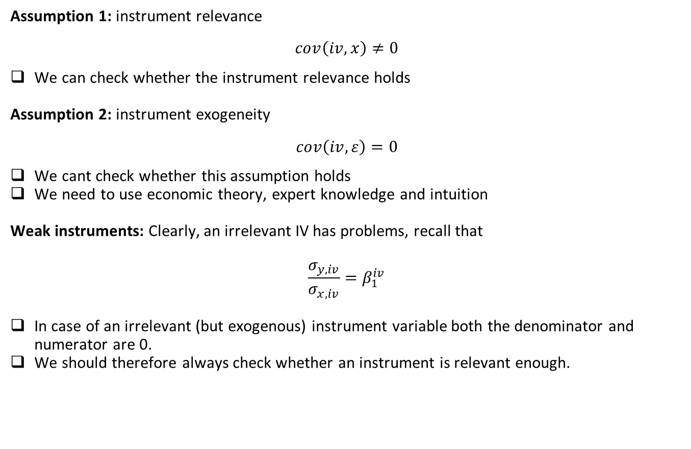
More assumptions (IV) and what about weak instruments
Assumption 1: instrument relevance
$$cov\left(iv,x\right)≠0$$
We can check whether the instrument relevance holds
Assumption 2: instrument exogeneity
$$cov\left(iv,ε\right)=0$$
We cant check whether this assumption holds
We need to use economic theory, expert knowledge and intuition
Weak instruments: Clearly, an irrelevant IV has problems, recall that
$$\frac{σ_{y,iv}}{σ_{x,iv}}=β_{1}^{iv}$$
In case of an irrelevant (but exogenous) instrument variable both the denominator and numerator are 0.
We should therefore always check whether an instrument is relevant enough.

Slide 13
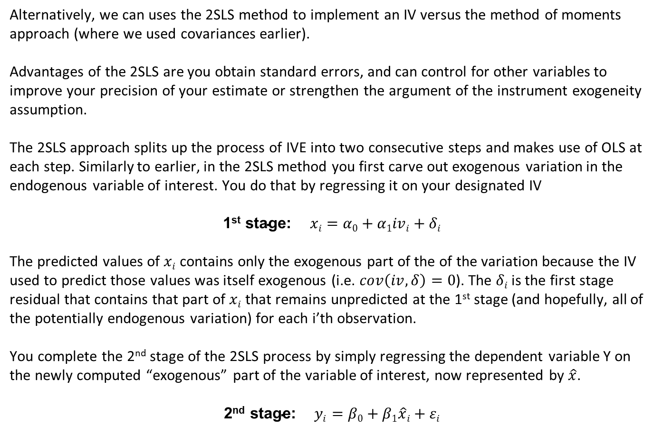
2SLS (two-stage-least-squares) approach to estimating IVs
Alternatively, we can uses the 2SLS method to implement an IV versus the method of moments approach (where we used covariances earlier).
Advantages of the 2SLS are you obtain standard errors, and can control for other variables to improve your precision of your estimate or strengthen the argument of the instrument exogeneity assumption.
The 2SLS approach splits up the process of IVE into two consecutive steps and makes use of OLS at each step. Similarly to earlier, in the 2SLS method you first carve out exogenous variation in the endogenous variable of interest. You do that by regressing it on your designated IV
$$\text{1}\text{st} \text{s}\text{tage}\text{: }xi=α0+α1ivi+δi$$
The predicted values of $xi$ contains only the exogenous part of the of the variation because the IV used to predict those values was itself exogenous (i.e. $cov\left(iv,δ\right)=0$). The $δi$ is the first stage residual that contains that part of $xi$ that remains unpredicted at the 1st stage (and hopefully, all of the potentially endogenous variation) for each i’th observation.
You complete the 2nd stage of the 2SLS process by simply regressing the dependent variable Y on the newly computed “exogenous” part of the variable of interest, now represented by $\hat{x}$.
$$\text{2}\text{nd} \text{stage}\text{: }yi=β0+β1\hat{x}i+εi$$
Notes:
The covariance approach that I have described works when you have a single outcome, a single variable of interest, and single instrument. The IV approach is typically applied in more complex data analytic settings.

Slide 14
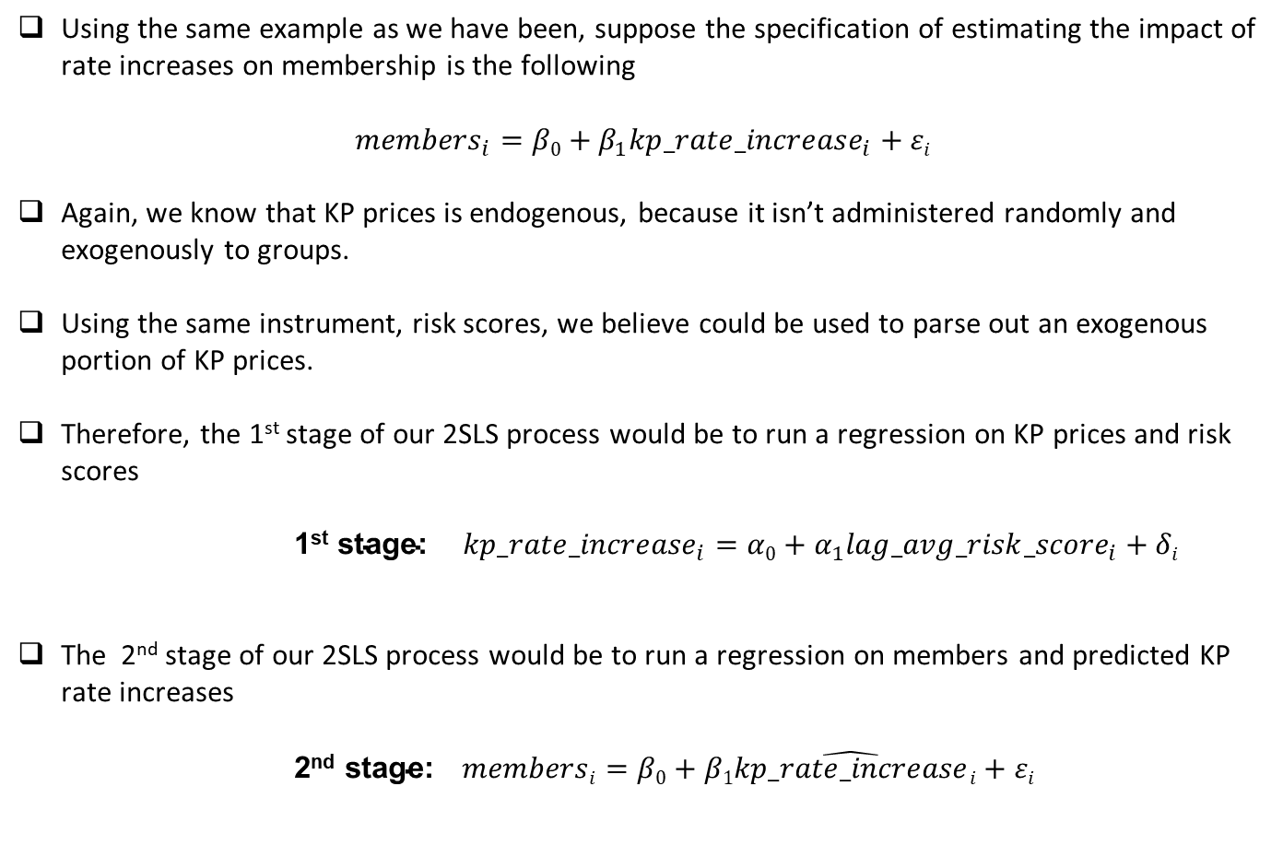
Example: instrument variable estimation (2SLS)
Using the same example as we have been, suppose the specification of estimating the impact of rate increases on membership is the following
$${members}_{i}=β0+β_{1}{kp_rate_increase}_{i}+εi$$
Again, we know that KP prices is endogenous, because it isn’t administered randomly and exogenously to groups.
Using the same instrument, risk scores, we believe could be used to parse out an exogenous portion of KP prices.
Therefore, the 1st stage of our 2SLS process would be to run a regression on KP prices and risk scores
$\text{1}\text{st} \text{stage}\text{: }{kp_rate_increase}_{i}=α0+α_{1}{lag_avg_risk_score}_{i}+δi$
The 2nd stage of our 2SLS process would be to run a regression on members and predicted KP rate increases
$\text{2}\text{nd} \text{stage}\text{:} membersi=β0+β1\hat{kp_rate_increase}i+εi$

Slide 15






A visual inspection of using IVs based on 2SLS
I can also use the earlier graphical analogy for IV methods to illustrate the process of 2SLS.
Recall that, the first stage of the 2SLS process, variable X is regressed on IV. The left panel highlights the darker blue ellipses. Their intersection represents their covariation and the part of the variation in X that has been carved out as exogenous and captured in the predicted values of X (e.g. $\hat{x}$). It is this part of the variation that is carried out through the 2nd stage.
The 2nd stage regresses Y on predicted values X. Note the residuals $δ$ are not apart of the 2nd stage.
1st Stage
2nd Stage
Variation in outcome Y, $σ_{y}^{2}$
Variation in outcome Y, $σ_{y}^{2}$
Variation in the instrument IV, $σ_{iv}^{2}$
Variation in the variable of interest X, $σ_{x}^{2}$
Predicted variation in the variable of interest X, $σ_{x}^{2}$
Residuals from the 1st stage, $δ$, are not used in the 2nd stage
Notes:
Since im only using the predicted values for x, my variation is smaller which drops the precision (standard errors goes up). Hence the importance of strong instruments.

Slide 16
Appendix

Slide 17
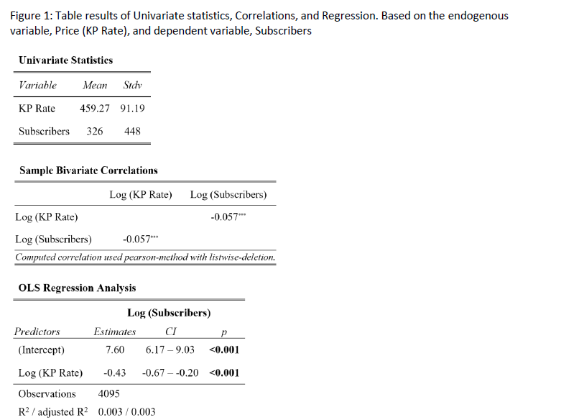
Example: IV estimation in action

Slide 18
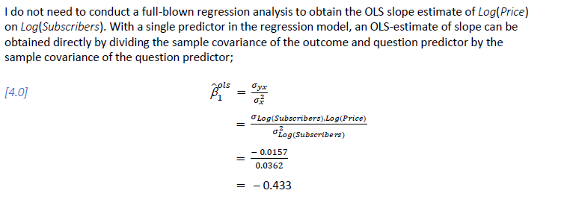
Example: IV estimation in action

Slide 19
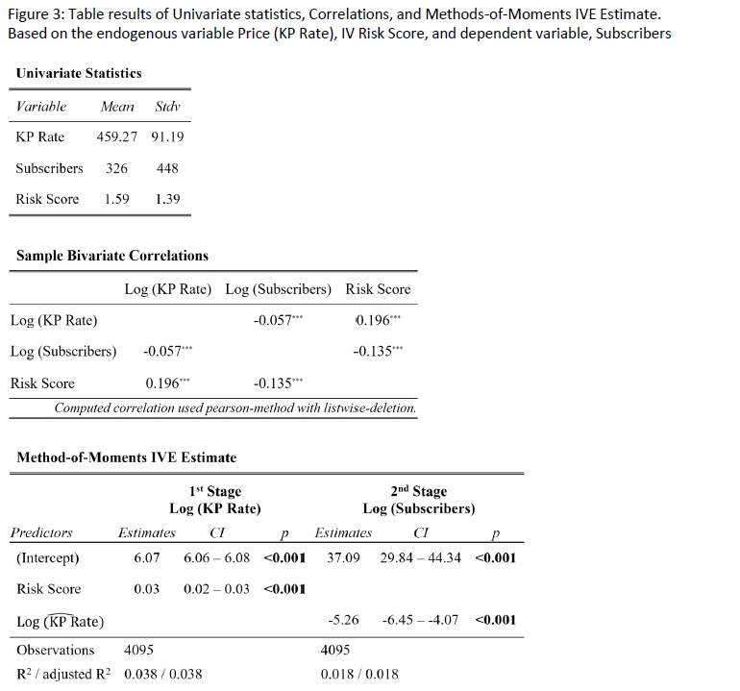
Example: IV estimation in action

Slide 20
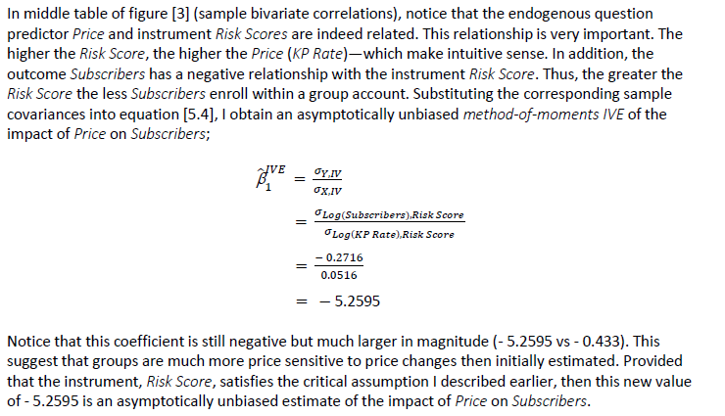
Example: IV estimation in action

Slide 21
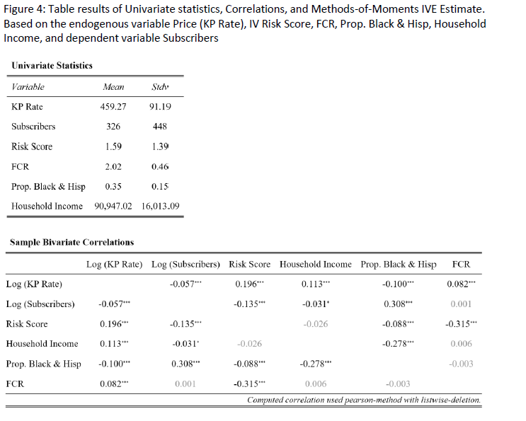
Example: IV estimation in action

Slide 22
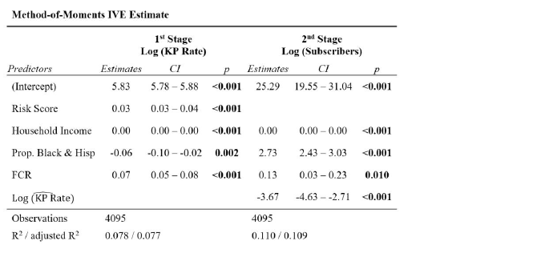
Example: IV estimation in action

Slide 23
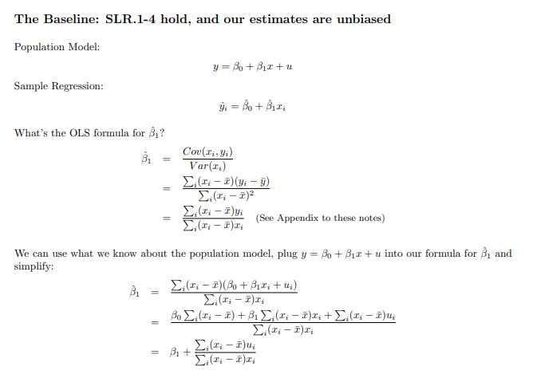
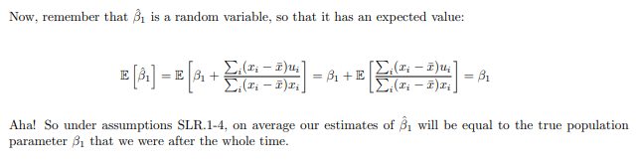
More stuff on omitted variable bias

Slide 24
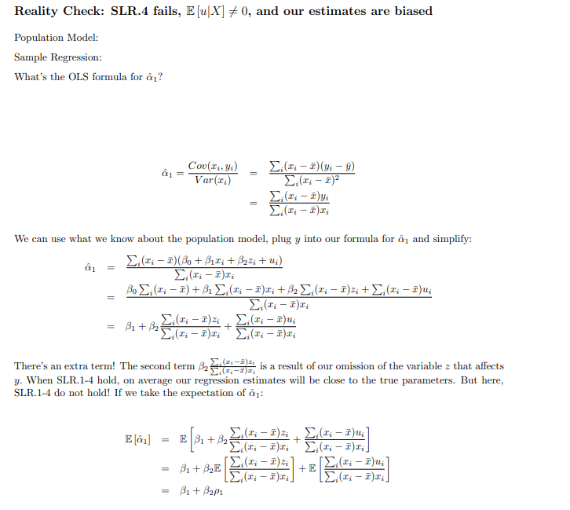
More stuff on omitted variable bias

